Slide 1
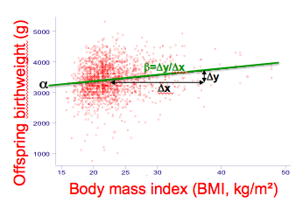


Fundamentals of Linear Regression Modelling with applications to Epidemiology and Clinical Research
Advanced Regression Modeling in Epidemiology and Clinical Research (2)
Marion Ouidir & Rémy Slama
Inserm and University Grenoble Alpes
U823, team of Environmental Epidemiology, Grenoble

Slide 2
Overview
Basic components of the linear regression model
Estimating the model’s parameters: the Least Squares method
More than 1 covariate: Multiple linear regression
Interaction (effect modification) in the linear regression model
Overview

Slide 3
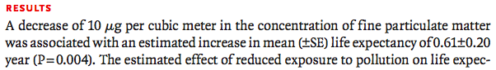
Main purposes of regression modelling in environmental epidemiology
Test: To test the association between exposure to an environmental factor and a health trait, controlling for other relevant factors.
Estimation: To quantify the change in the level or frequency of a health trait according to the level of exposure to a given environmental factor
Prediction: To predict the frequency or level of a health trait according to the characteristics of each observation (subjects, communities…)

Slide 4
Regression: principle
Starting point
We are interested in the variations of the level or frequency of a health trait represented by a variable Y.
Y has been assessed among subjects of a given population.
X is a variable representing another factor (e.g., exposure to an environmental factor).
To regress Y according to X is to describe how the average value* of Y varies according to X.
* Or another statistical function of Y

Slide 5
E(Y)
E(Y/X=x₂)
E(Y/X=x₁)
x₁
x₂
X

Slide 6

I. Basic components of the linear regression model
Sir Francis Galton (1822-1911)

Slide 7
The linear regression model
E(Y) = α + β₁X₁ + β₂X₂ +…+ β_{p}X_{p}
Expected value of Y
It is also the value predicted by the model.
X₁, … X_{p} are the independent or explanatory variables or covariates
Y is called the dependent or explained variable
α, β₁ … β_{p} are the model’s parameters.

Slide 8

What comes in? What goes out?
E(Y) = α + β₁X₁ + β₂X₂ +…+ β_{p}X_{p}
Expected value of Y
It is also the value predicted by the model.
X₁, … X_{p} are the independent or explanatory variables or covariates
Can also be estimated by the software
You measure them in the study population
Y is called the dependent or explained variable
You measure it in the study population
α, β₁ … β_{p} are the model’s parameters.
The software estimates them for you

Slide 9
I.1) The explained variable (Y)
The explained variable (usually a health or biological parameter) Y is assessed on a continuous scale
Y can take on many values; typically, the number of different values of Y increases with the number of subjects in the study.
Y must not be a survival duration

Slide 10
I.2) The covariates X₁… X_{p}
“Scatter plot of observations”
Y (birth weight of offspring, g)
Y_{i}
X_{1i}
observation i
X₁ (maternal body mass index, kg/m²)
Observation | Y | X₁ | X₂
1 | Y₁ | X₁₁ | X₂₁
2 | Y₂ | X₁₂ | X₂₂
… | … | … | …
i | Y_{i} | X_{1i} | X_{2i}
… | … | … | …
N | Y_{N} | X_{1N} | X_{2N}
Data set
(N observations)

Slide 11
Several types of covariates
Binary covariates
These only can take 2 values
e.g.: sex = Female or male
or HIV serology : HIV+/HIV-
Categorical covariates
These variables can take a finite (<<n) number of possible values, strictly greater than 2. They are either
-ordered
If there is a natural ‘scale’
e.g.: Number of children: 1, 2, 3, …,10.
-not ordered
If there is no obvious scale or ranking among values
E.g.: City of recruitment (in a multicentric study)
HIV+
HIV-
Country

Slide 12
Continuous covariates
They can take a very large number of values, usually in a given interval.
There is a natural scale. Usually, there is a unit (and the choice of the unit will to some extent the estimates of the regression model)
E.g.: blood pressure (mm Hg), biomarker’s concentration…
In practice, since the number of digits given by most measurement tools is limited (as well as their accuracy), the corresponding covariate actually varies on a discontinuous scale
For height, increments are usually by 1 mm or more
As soon as a covariate can take a very large number of values (much larger than the number of observations n), we will call it a continuous covariate
Density function f
f(x).dx is an estimate of the proportion of observations for which X is between x and x+dx, if dx is ‘small’
Histogram
X

Slide 13
One should distinguish
The coding of a covariate in the regression model
The value measured or estimated by the “tool” used by the researcher (biochemical assay, dosimeter, reply to a questionnaire…)
The underlying theoretical notion
X: Age<35 Y/N
Age in years
“Aging”

Slide 14
I.3) The model’s parameters
E(Y) = α + β₁X₁ + β₂X₂ +…+ β₂X_{p}
Intercept (α)
α corresponds to the value of Y predicted by the model for subjects among whom X=0 (or X₁=X₂=…X_{p}=0 if there are several covariates)
Here, this would correspond to the birth weight of children whose mother has a BMI of 0!
α therefore does not always have a concrete interpretation.
α
Offspring birthweight (g)
Body mass index (BMI, kg/m²)

Slide 15
The parameter β (slope)
β is the slope of the line describing the relation between the predicted value E(Y) and X₁.
When X increases by 1, E(Y) varies by β.
(This is an estimation based on the data, this is not necessarily reality)
β has a unit (corresponding to the ratio of the units of Y/X).
The value of β will change if the scale on which X or Y are assessed change.
β therefore quantifies the estimated association between X₁ and Y:
If β>0, then Y tends to increase when X increases.
If β<0, then Y tends to decrease when X increases.
The larger β in absolute value, the larger the variations in E(Y) when X varies by 1.
If β is close to 0, then variations by 1 in X are not associated with large variations in Y.
β is estimated together with a confidence interval and cannot be interpreted without it.

Slide 16
β=Δy/Δx
α
Δy
Δx
Offspring birthweight (g)
Body mass index (BMI, kg/m²)
E(Y/X=x)=α + β.x

Slide 17
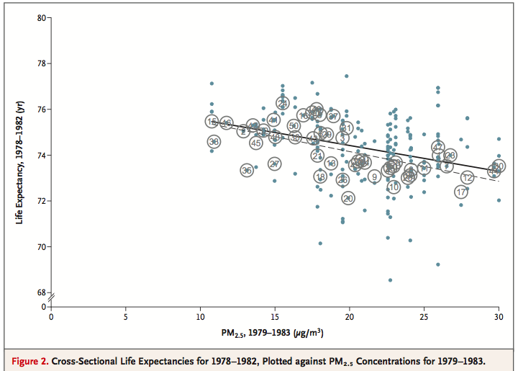
Example 2: Mean particulate matter (PM2.5) level and life expectancy in US cities
Complex dataset
Simple result
(Arden Pope et al., NEJM, 2008)

Slide 18

The slope (β)
Δy
Δx
X₁: binary variable
X₁: quantitative variable
E(Y)
E(Y)
α+β
α+a.β + βΔx
α+a.β
Δy
Δx
β=Δy/Δx
α
α
X₁
X₁=0
X₁=1
X₁
X₁=a
X₁=a+Δx
If X increases by 1, the estimated (or predicted) value of Y increases by β

Slide 19
Example: Interpretation of the parameters of a linear regression model
Offspring birthweight (g)
Coefficients:
Source | SS df MS Number of obs = 1853
-------------+------------------------------ F( 1, 1851) = 13.57
Model | 3527802.39 1 3527802.39 Prob > F = 0.0002
Residual | 481362511 1851 260055.381 R-squared = 0.0073
-------------+------------------------------ Adj R-squared = 0.0067
Total | 484890313 1852 261819.823 Root MSE = 509.96
------------------------------------------------------------------------------
m6 | Coef. Std. Err. t P>|t| [95% Conf. Interval]
-------------+----------------------------------------------------------------
β bmi | 9.518238 2.584267 3.68 0.000 4.449854 14.58662
α _cons | 3056.665 61.14635 49.99 0.000 2936.742 3176.588
------------------------------------------------------------------------------

Slide 20
Going a bit further with continuous covariates
So far, we have assumed that the variable X corresponds to the natural quantity whose relation to Y need to be characterized, without transformation.
For example, X can be age in years, or air pollution concentration (in μg/m³ in the air) or the concentration of a biomarker in blood…
In fact, the variable X could as well correspond to a transformed value of this natural quantity.
For example, X can be the square value of age (in which case its unit is years²) or the logarithm of air pollution or of the biomarker concentration (X=ln(c))in μg/m³ in the air)
In this later case, what is the interpretation of the parameter β associated with X?

Slide 21
A) If X corresponds to the untransformed quantity
B) If X corresponds to a transformed value of the quantity of interest
X₁: quantitative variable
X₁: = ln(c)
E(Y)
E(Y)
α+a.β + β
α+a β + β
β=Δy
β=Δy
α+a.β
α+a β
Δx=1
Δx=1
α
α
X₁
X₁
X₁=a
X₁=a+1
X₁=ln(c)
X₁=ln(c)+1
For A) and B): if X increases by 1, the estimated (or predicted) value of Y increases by β
If X increases by 1, ln(c) increases by 1
(Remember that an increases by 1 in ln(c) corresponds to an multiplication of c by e=2.718…)
(This also corresponds to an increase in X by 172%...)
If c is multiplied by 2.718 (or increases by 172%), then the predicted value of Y increases by β

Slide 22
X scale
Untransformed scale
X₁: = ln(c)
E(Y)=α+β.ln(c)
E(Y)
E(Y)
α+a β + β
β=Δy
α+a β
β
Δx=1
α
X₁
X₁=ln(c)
X₁=ln(c)+1
a
a’
c
a’=a.2.718
If c is multiplied by 2.718 (or increases by 172%), then the predicted value of Y increases by β
Notes:
COMPLETER PAR TABLEAU AVEC AUTRES SITUATIONS : X2, X1/2 etc.

Slide 23
Interpretation of the parameter associated with continuous covariates: What you need to remember
The parameter β associated with X depends on the unit in which X is expressed
(if you move from mg/l to g/l, β will be multiplied by 1000)
It depends on whether or not X corresponds to a transformed quantity or not
Replacing a quantity by its squared value or logarithm will also modify β
You cannot interpret β without considering the quantity corresponding to the underlying covariate

Slide 24
Taking into account categorical covariates
Assume that we want to describe possible differences in blood pressure between the population from 3 cities, adjusting for potential confounders.
Blood pressure
Your dataset includes
The blood pressure variable Y
A variable X indicating city (1 for Paris, 2 for Grenoble, 3 for Saint-Tropez)
A variable Z corresponding to a potential confounder (e.g., cigarette smoking yes/no)
Write down the regression model you would like to run.

Slide 25

Anyone? Anyone?

Slide 26
Suggestion #1
E(Y) = α + βX + γZ (M1)
In model 1, both covariates are simply entered as continuous terms.
β≈0
Blood pressure
X
The parameter β associated with the city (X) will correspond to the average trend between the 3 cities. In this case, this will correspond to a slope close to 0 (if the number of subjects is the same in all 3 cities) and the corresponding p value would be high.
Conclusion from model #1: There is no clear trend in blood pressure between the 3 cities

Slide 27
Why suggestion #1 is not a relevant idea…
The coding of variable X indicating city is totally arbitrary.
Assume that for some reason we choose another order:
X’ = 1 for Saint-Tropez, 2 for Paris and 3 for Grenoble
The histogram would now look like this:
β’<0
X’
The parameter β‘ associated with the city (X’) will correspond to the average trend between the 3 cities. In this case, this will correspond to a negative slope, with a possibly low p values (if a large number of subjects were recruited in each city.
Conclusion from modified model #1: There is a clear decreasing trend in blood pressure between the 3 cities

Slide 28


Slide 29
Obtaining a relevant estimate of the impact of categorical covariates using dummy variables
Suggestion #2
1) One creates 3 new covariates X₁, X₂ and X₃ defined according to the original covariate X as shown in this table
For a given value of X, there is one and only one combination of the 3 covariates X₁, X₂ and X₃.
If you know X₁, X₂ and X₃ , you also know X (and vice versa)
X₁, X₂ and X₃ are called dummy variables
X | X₁ | X₂ | X₃
1 (Paris) | 1 | 0 | 0
2 (Grenoble) | 0 | 1 | 0
3 (St Tropez) | 0 | 0 | 1

Slide 30
Suggestion #2 (continued)
2) One estimates a regression model M2 without the covariate X but with 2 of the newly created binary variables X₂ and X₃.
E(Y) = α + β₂X₂ + β₃X₃ + γZ (M2)
The information on city is now incorporated in these 2 binary variables

Slide 31
Dummy variables: why does it work?
Let us write Y₁ the mean value of Y in the city corresponding to X=1
X=1 ➔ X₂=0 and X₃=0: E(Y₁)= α + γZ
X=2 ➔ X₂=1 and X₃=0: E(Y₂)= α + β₂ + γZ
X=3 ➔ X₂=0 and X₃=1: E(Y₃)= α + β₃ + γZ
➔ β₂ is an estimate of the difference in Y between cities 2 and 1 (adjusted for Z)
➔ β₃ is an estimate of the difference in Y between cities 3 and 1 (adjusted for Z)
This model (M2) allows to estimate 2 different parameters, β₂ and β₃, to represent the city. These allow two distinct comparisons: on the one hand between city 2 and city 1, and on the other hand between city 3 and city 1. City 1 corresponds to the reference level.
Note:
Instead of X₂ and X₃, one could have run a model with the dummy variables X₁ and X₃. In this case, city X=2 would be the reference category (instead of city X=1 in the example above).

Slide 32
Values predicted by model M2
β₃
β₂
Blood pressure
X₂
X₃
Reference category

Slide 33

Caveat: Covariates X₁, X₂, X₃ always go together. They have no meaning on their own and cannot be excluded or included in the regression model independently one from another.

Slide 34
Case of a categorical covariate X with 4 levels or more
The same principle can be generalized: if X has k levels, k dummy variables X₁, … , X _{k} should be created.
And the k-1 covariates X₁…X_{k-1} are used in the regression model instead of X
This is why we say it generally takes k-1 covariates to estimate the effect of a variable with k different values.
One should avoid choosing a reference category with very few subjects.
(See e.g. Hosmer & Lemeshow, 2000).
X |  | X₁ | X₂ | … | X_{i} | … | X_{k}
1 |  | 1 | 0 | 0 | 0 | 0 | 0
2 |  | 0 | 1 |  | 0 |  | 0
… |  |  |  |  | 0
i |  |  |  |  | 1
… |  |  |  |  | 0
k |  | 0 | 0 | 0 | 0 | 0 | 1

Slide 35
Dummy variables: overview
Dummy variables can (should) be used to model the relation between a categorical covariate and a health outcome Y.
They avoid making the a priori assumption of a monotonous relation between X and the expected value of Y.
(M1)
E(Y) = α + β₂X₂ + β₃X₃ + β₄X₄
(M2)
3β
2β
β₄
β
β₂
α
β₃
The height of each step is always the same
The height of each step can vary for each category of X

Slide 36
II.4) The predicted values: E(Y)
Offspring birthweight (g)
Regression line predicted by the model
X₁=30
According to this model, if maternal BMI (X₁) has a value of 30, offspring birth weight (Y) will be on average 3500 g.
3500 g is the value of Y predicted for subjects with X₁=30

Slide 37
II.4) The predicted values: E(Y) (or )
In reality, the observed values of Y_{i} for observations with X1=30 will NOT be 3500 g
Offspring birthweight (g)
Regression line predicted by the model
X₁=30
According to this model, if maternal BMI (X₁) has a value of 30, offspring birth weight (Y) will be on average about 3500 g.
3500 g is the value of Y predicted for subjects with X₁=30

Slide 38
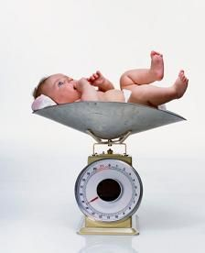
Question: What is the value of Y predicted for a woman with a BMI of 30 kg/m²?
Coefficients:
Source | SS df MS Number of obs = 1853
-------------+------------------------------ F( 1, 1851) = 13.57
Model | 3527802.39 1 3527802.39 Prob > F = 0.0002
Residual | 481362511 1851 260055.381 R-squared = 0.0073
-------------+------------------------------ Adj R-squared = 0.0067
Total | 484890313 1852 261819.823 Root MSE = 509.96
------------------------------------------------------------------------------
m6 | Coef. Std. Err. t P>|t| [95% Conf. Interval]
-------------+----------------------------------------------------------------
β bmi | 9.518238 2.584267 3.68 0.000 4.449854 14.58662
α _cons | 3056.665 61.14635 49.99 0.000 2936.742 3176.588
------------------------------------------------------------------------------

Slide 39

E(Y/X=x) is the predicted value, i.e. the model’s best guess of Y for subjects among whom X has a value of x. E(Y)=
E(Y/X=x)=α + β.x
If X has a value of 25, given the values of α and β estimated by the statistical software with the data at hand (see previous slide), the predicted value is…
Beware of units!
α has the same unit as Y
β has the same unit as Y/X
E(Y/X=25)=α + β.x= 3057+ 9.518.25 = 3295 g

Slide 40
Predicting from a regression model
In theory, once it has been fitted, the regression model allows you to predict an expected Y value for any value of the covariates X
You just need to apply the formula using the estimated values of the parameters
E(Y/X=x)=α + β.x
In practice, however, you should only do that for realistic values of x (values of X that are well within the distribution of X observed in your dataset).
For example, if you fit a regression model to predict cholesterol level in a population of subjects aged 20 to 45, you should not use this model to predict the mean cholesterol level in subjects aged 80 years.

Slide 41
A note on terminology
The model corresponds to a simple regression model
Simple is used here to indicate that there is only one covariate (X).
The variable X could be coded differently than with β.X.
For example, a term γ.X² or δ.ln(X) could be added.
This would still be a linear model
(remember that linear applies to the parameters α, β… and not to the covariates!)
Other covariates (X₂, X₃…) could be added to the right hand term of the model
➔ The model would then be termed a multiple linear regression model.

Slide 42
II.5) Predicted versus observed values: the model’s residuals
Observation i
ε_{i}
Offspring birthweight (g)
Maternal body mass index

Slide 43
The residual expresses how far an observation lies from the model’s prediction.
What relates the (« theoretical ») model
E(Y/X=x)= α + β.x
To the observed (“real”) data?
The variation between the value of Y observed and the value predicted for each subject i corresponds to the residual of subject i:
ε_{i} = y_{i} – E(Y/X_{i}=x_{i}) = = y_{i}- (α + β.x_{i})

Slide 44
Residuals: Properties and assumptions
By taking the expected value of the previous expression, one notices that:
E(ε_{i})=E[ y_{i} – E(Y_{i}) ] = E(y_{i}) – E[E(Y_{i})]=E(Y_{i} )– E(Y_{i})=0
➔ (ε_{i}) are null in expectation (“on average”).
ε_{i} are also assumed to be independent
And identically distributed (they should have the same variance)
These assumptions are done by the approach used to estimate the model’s parameters α and β (the least square approach).
Some of these approaches can be relaxed using alternative approaches to estimate the model’s parameters.
In practice, some of these assumptions are checked by plotting the model’s residuals as a function of one explanatory variable or of the predicted value of Y.
N.B.: Some authors recommend to plot Student’s residuals (Armitage, Statistical Methods in Medical Research, 2002)

Slide 45
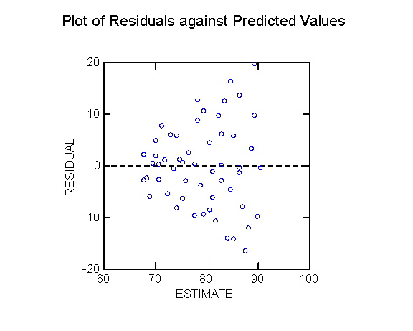
Here, the residual’s variance seems to increase with the predicted value of Y.
In this case, you should not trust too must the model’s estimate, but rather try to come out with another (better) model.

Slide 46
3 equivalent ways to write the simple linear regression model
The linear regression model
E(Y/X=x) = α + β.x
Can now be rewritten as:
Y = α + β.x + ε
Or, if we include i to indicate the observation (i=1, …, n)
Y_{i} = α + β.x_{i} + ε_{i}

Slide 47

II. Estimating the model’s parameters: The Least Squares (or OLS) method
Adrien-Marie Legendre (1752-1833)
The linear regression model (continued)
Advanced Regression Modeling in Epidemiology and Clinical Research (2)

Slide 48
Assume X and Y have been assessed in N subjects.
We would like to fit a linear regression model to the data:
E(Y_{i}/X_{i}=x_{i})= α + β.x_{i}
How can α and β be estimated (i.e., how do we “draw” the “best” regression line?)
One commonly used approach is the least squares (or Ordinary Least Squares, OLS) method:
It consists in choosing the values of α and β that minimise the sum of the square values of the residuals of all observations.

Slide 49
Y
Another possible regression line (with a higher sum of squares)
ε_{i}
1 possible regression line
X
SS: sum of squares

Slide 50
It can be shown that the OLS estimate of the parameter(s) β equals
Where X is the vector of covariates,
X^{T} its transposed matrix
And β the vector of the estimated parameters
Equivalently, β also corresponds to:

Slide 51
R² quantifies the proportion of the variability in Y explained by the model
Y
High R²
Y
Low R²
X
X
R² quantifies the predictive ability of the fitted model.
If you know X, you can predict Y with a good accuracy
Here, for a given value of X, Y varies over a large range. Knowing X provides more limited information on Y.

Slide 52
Some remarks…

Slide 53
Relation between R² and ρ
In simple linear regression (one single covariate), R² corresponds to the square value of the coefficient of correlation ρ between Y and X.

Slide 54
Relation between ρ and β
ρ varies between -1 and +1
ρ=0 indicates no correlation between X and Y
Can take any value. Has the same sign as ρ
0 indicates no association between X and Y
In consequence, if X and Y are both standardized (i.e., both have a variance of 1), the coefficient of correlation between X and Y will equal the parameter β of the regression model (not adjusted for any other covariate).

Slide 55

R² is not equivalent to p!
Relates to the model as a whole.
Quantifies its predictive ability
Significance level associated with a given covariate.
If the number of observation is high, the association can be very significant (i.e., low p-value) even if there is a lot of dispersion around the regression curve (low R²)
In other words, a covariate X can be significantly associated with Y without being able to predict efficiently.

Slide 56
An example
But the model’s R² is very low (i.e. the model explains a very small proportion of the birth weight variability)
bmi is a “very significant predictor” of Y
Coefficients:
Source | SS df MS Number of obs = 1853
-------------+------------------------------ F( 1, 1851) = 13.57
Model | 3527802.39 1 3527802.39 Prob > F = 0.0002
Residual | 481362511 1851 260055.381 R-squared = 0.0073
-------------+------------------------------ Adj R-squared = 0.0067
Total | 484890313 1852 261819.823 Root MSE = 509.96
------------------------------------------------------------------------------
Birth weight | Coef. Std. Err. t P>|t| [95% Conf. Interval]
-------------+----------------------------------------------------------------
β bmi | 9.518238 2.584267 3.68 0.000 4.449854 14.58662
α _cons | 3056.665 61.14635 49.99 0.000 2936.742 3176.588
------------------------------------------------------------------------------

Slide 57
Linear regression modeling is not “symmetrical”
The coefficient of correlation between x and y is the same as that between y and x: symmetry
This is not true for the parameters of the linear regression model (the betas will generally differ)
(Remember that: )
However, if one regresses Y over X (without other adjustment factors)
E(Y)=α + βX
and if there is an association (“small p value” for the parameter β), then there will also be an association if one regresses X over Y
E(X)=α’ + β’Y

Slide 58

A more complex one…
R² is said to be optimistic
This means that if you fit a model and estimate R², the value you obtain will generally be higher than the value of R² that you would obtain if you fitted the model to a new dataset.
Solution: Estimate a cross-validation R² instead of the classical R² (not detailed)

Slide 59
What does linear mean?
The model
E(Y/X=x) = α + β₁.X₁ + β₂.X₂ + β₃.X₃
is called a linear model because the right-hand term is a linear combination of parameters (α, β₁, β₂, β₃)
(there is no term like β₁x β₂ x X₁)
However, the right hand expression needs not be a linear combination of variables X₁, X₂ and X₃.
For example, the model
is also a linear regression model…
(even if the right-hand term is not a linear function of X₁)

Slide 60
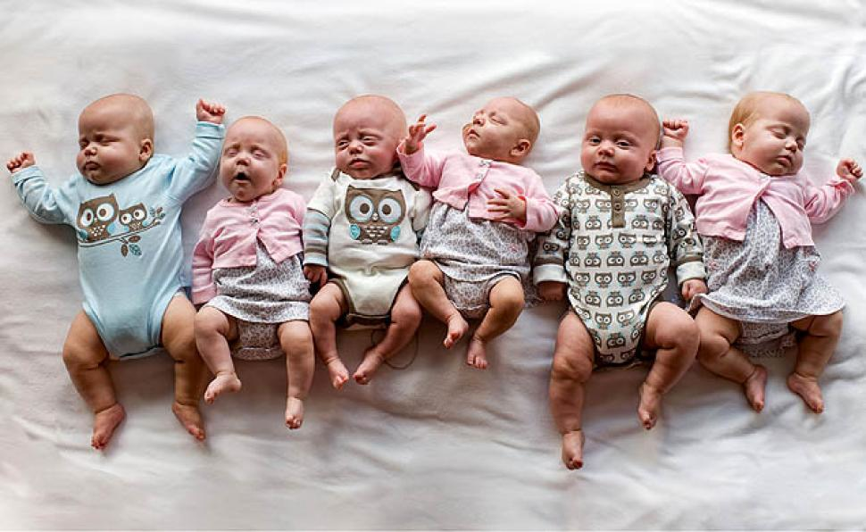
III. More covariates: multiple linear regression

Slide 61
We will now consider a linear regression models with 2 covariates:
E(Y/X=x) = α + β₁.X₁ + β₂.X₂ + β₃.X₃
What we have said before regarding the estimation of parameters still holds.
Regarding the parameters’ interpretation:
α is now the predicted value of Y for subjects with X₁=0 and X₂=0 and X₃=0
What is the interpretation of β₁?

Slide 62
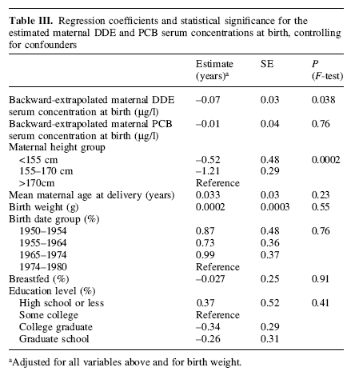
Example: In utero exposure to DDE and PCB and age at menarche
DDE: dichlorodiphenyl-dichloroethylene (metabolite of pesticide DDT).
PCB: Polychlorinated biphenyls.
(Vasiliu, Human Reprod, 2004)

Slide 63
Interpreting β₁ in the presence of several covariates
X₂ has a value of x₂; X₃ has a value of x₃.
Among subjects for whom X₁=0:
Y₀ , the expected value of Y in these subjects, is:
(III.1)
Among subjects for whom X₁=1:
Y₁, the expected value of Y in these subjects, is:
(III.2)
β₁ can be expressed by subtracting (III.1) from (III.2):

Slide 64
(III.2)-(III.1)
^
^
β₁ is an estimate of the variation in Y when X₁ varies from 0 to 1, assuming that X₂ and X₃ remain constant.
In other words, it is the estimated effect of X₁ on Y adjusted for X₂ and X₃.

Slide 65
Δy
Δx
X₁: binary variable
X₁: quantitative variable
E(Y)
E(Y)
α+β
α+a β + β
α+a β
Δy
Δx
β=Δy/Δx
α
α
X₁
X₁=0
X₁=1
X₁
X₁=a
X₁=a+1

Slide 66
Values predicted by a multiple regression model with 2 covariates
X₁: quantitative variable
X₂: binary variable
E(Y)
X₂=1
β₂
X₂=0
X₁

Slide 67

What is the maximum number of covariates* a regression model can accommodate? A convenient rule of thumb
Linear regression, n observations
You should not estimate more than n/10 parameters
E.g., with 200 subjects, there should not be more than 19 binary covariates in the model.
Remember that if age is coded with 6 categories, it takes 5 dummy (binary) variables to estimate its effect.
If the number of covariates becomes too large, the model’s estimate are likely to become less stable and reliable (but there may be no obvious warning sign!)
*More precisely: of parameters to estimate

Slide 68

Regression models are flexible

Slide 69
Relation between R² and ρ
In simple linear regression (one single covariate), R² corresponds to the square value of the coefficient of correlation ρ between Y and X.
In multiple linear regression (several covariates), R² corresponds to the square value of the coefficient of correlation ρ between Y and the predicted values of the regression model.
It is therefore still true that R² quantifies the predictive ability of the fitted model.

Slide 70
IV. Interaction (effect measure modification) in the linear regression model

Slide 71
Allowing effect measure modification between covariates
One speaks of effect measure modification when the apparent effect of a variable X₁ is different in subgroups defined by another covariate
For example, the effect of smoking on cardiovascular diseases may be stronger (or weaker) in men than in women
(this is sometimes called interaction, but this term has many different meanings and should be avoided)
By default, the regression model
E(Y)=α+β₁X₁+β₂X₂
will not be able to tell you that the effect measure of X varies with X₂ if you do not ask him…

Slide 72

A more complex model
A solution is to add another variable in the model that simultaneously depends on X₁ and X₂.
For example, the product of X₁ and X₂ can be used:
E(Y)=α+β₁X₁ + β₂X₂ + γ. X_{1.}X₂
(IV.1)

Slide 73
Let us assume for simplicity that X₂ is a binary covariate (with values 0 or 1). We will write the values predicted by the model IV.1 above in several groups:
If X₂=0, then the model is written
E(Y)= α + β₁X₁ + 0 + γ.1.0 = α + β₁X₁
➔ β₁ is an estimate of the effect of X₁ in subjects not exposed to X₂ (subjects with X₂=0)
If X₁=0, then the model is written
E(Y)= α + 0 + β₂. X₂ + γ.0.1= α + β₂X₂
➔ β₂ is an estimate of the effect of X₂ in subjects not exposed to X₁ (subjects with X₁=0)
If X₁=x₁ and X₂=1, then the model is written
E(Y)= α+β₁.X₁+β₂. X₂ + γ. X₁. X₂= α + β₁.X₁ + β₂.1 + γX₁= α+β₂+(β₁+γ)X₁
Parameter associated with X₁ if X₂=1

Slide 74
Consequently, it appears that the model
E(Y)=α+β₁X₁ + β₂X₂ + γ. X_{1.}X₂
allows us to obtain:
an estimate of the effect of X₁ in subjects not exposed to X₂ (β₁)
an estimate of the effect of X₂ in subjects not exposed to X₁ (β₂)
an estimate of the effect of X₁ in subjects exposed to X₂ (β₁+γ)
In other words, we now allowed for the effect of X₁ to differ according to the value of X₂
(or, equivalently, for the effect measure of X₁ to be modified by X₂)

Slide 75
Effect measure modification Plot of the predicted values with one continuous covariate (X₁) and a binary covariate (X₂)
E(Y)
X₂ = 1
slope: β₁+γ
X₂ = 0
slope: β₁
X₁
The estimated effect of X is different for subjects with X₂=0 and for those with X₂=1.

Slide 76
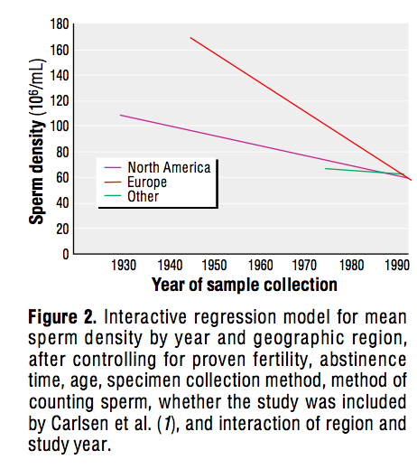
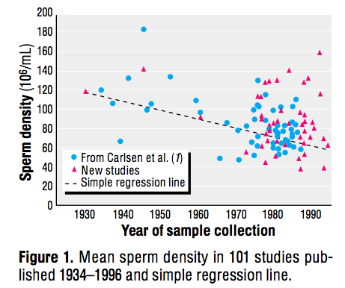
Example: Changes in mean sperm count over time
2. Linear regression analysis with interaction terms between year and Continent
1. Linear regression analysis without interaction term
(Swan, EHP, 2000)

Slide 77
What if X₁ and X₂ are both binary variables?
The same model can be used
E(Y)=α+β₁X₁ + β₂X₂ + γ. X_{1.}X₂
(IV.1)
Since X₁ and X₂ are both binary variables, we will assume that they are both coded with the values 0 and 1 (this is usually the safest option).
In this case, X₁.X₂ is an indicator variable with a value of 1 if and only if both X₁ and X₂ have a value of 1.
Let us write the values predicted by this model in the 4 categories defined by all the possible combinations of X₁ and X₂:
 |  | X₁
 |  | 0 | 1
X₂ | 0 | α | α+β₁
 | 1 | α+β₂ | α+β₁+β₂+γ
Predicted values E(Y):

Slide 78
More interesting interactions…
If X₁ is a continuous variable and X₂ is a binary variable
Simple interaction term (see above)
If X₁ and X₂ are binary
Simple interaction term (see above)
If X₁ is a categorical variable and X₂ binary
It is safer to code X₁ with dummy variables (k-1 if X₁ has k categories)
And to add an interaction term with each of these dummy covariates
If X₁ and X₂ are continuous covariates
A safe option is to transform them in categories, code them by dummy variables, and create interaction terms for all the pairwise combinations of the dummy covariates. This means (j-1)x(k-1) terms for the interaction if X₁ and X₂ are coded with j and k categories.

Slide 79
V. As a conclusion Regression models are flexible…

Slide 80
…Flexible in terms of ability to take into account potential confounders
We have seen that various types of adjustment covariates can be taken into account
Binary, categorical, continuous covariates
Beware of the coding of categorical and continuous covariates in the model!
Do not ask the model to estimate too many parameters at the same time
Limit to n/10, where n is the number of observations in the regression model

Slide 81
…Flexible in terms of allowing effect measure modification between covariates
One speaks of effect measure modification when the apparent effect of a variable X is different in subgroups defined by another covariates
For example, the effect of smoking on cardiovascular diseases may be stronger (or weaker) in men than in women
(this is sometimes called interaction, but this term has many different meanings and should be avoided)
By default, the regression model E(Y)=α+β₁X₁+β₂X₂ will not be able to tell you that the effect measure of X₁ varies with X₂ if you do not ask him…
A solution is to add another variable in the model that simultaneously depends on X₁ and X₂.
For example, the product of X₁ and X₂ can sometimes be used:

Slide 82
Effect measure modification Plot of the predicted values with one continuous covariate (X) and a binary covariate (X₂)
E(Y)
X₂ =1
slope: β₁+γ
X₂ =0
slope: β₁
X₁
The estimated effect of X is different for subjects with X₂=0 and for those with X₂=1.

Slide 83
When contemplating the output of a regression model, what should you look at in priority?
The number of observations
The model’s R²
Coefficients:
Source | SS df MS Number of obs = 1853
-------------+------------------------------ F( 1, 1851) = 13.57
Model | 3527802.39 1 3527802.39 Prob > F = 0.0002
Residual | 481362511 1851 260055.381 R-squared = 0.0073
-------------+------------------------------ Adj R-squared = 0.0067
Total | 484890313 1852 261819.823 Root MSE = 509.96
------------------------------------------------------------------------------
Birth weight | Coef. Std. Err. t P>|t| [95% Conf. Interval]
-------------+----------------------------------------------------------------
β bmi | 9.518238 2.584267 3.68 0.000 4.449854 14.58662
α _cons | 3056.665 61.14635 49.99 0.000 2936.742 3176.588
------------------------------------------------------------------------------
Check that the expected covariates are in the model
(here, only one: bmi)
Look at the estimated parameters, and their confidence interval (p-values are not so important)

Slide 84
A summary…
R² quantifies the predictive ability of the fitted model.
E(Y) = α + β₁X₁ + β₂X₂ +…+ β_{p}X_{p}
Expected value of Y.
This is the value predicted by the model.
X₁, … X_{p} are the independent or explanatory variables or covariates
Can be estimated by the software
You measure them in the study population
Y is called the dependent or explained variable
α, β₁ … β_{p} are the model’s parameters.
You measure it in the study population
The software estimates them for you

Slide 85
Thank you for your attention!

